Slide 1
Operating System

Slide 2
What is operating system?
An Operating System (OS) is an interface between a computer user and computer hardware and controls the execution of all kinds of programs.
An operating system is a software which performs all the basic tasks like file management, memory management, process management, handling input and output, and controlling peripheral devices such as disk drives and printers.
An operating system is software that enables applications to interact with a computer's hardware.

Slide 3
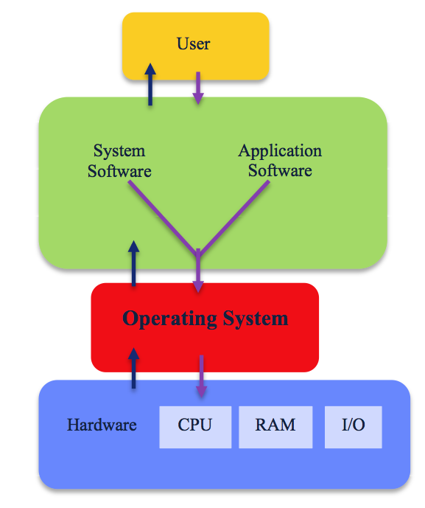
Fig. Operating system

Slide 4
The software that contains the core components of the operating system is called the kernel.
Kernel is the core that provides basic services for all other parts of the OS.
Kernel is the main layer between the OS and underlying computer hardware, and it helps with tasks such as process and memory management, file systems, device control and networking.
The primary purposes of an Operating System are to enable applications to interact with a computer's hardware and to manage a system's hardware and software resources.
Some popular Operating Systems include Apple macOS, Microsoft Windows, Google's Android OS, Linux Operating System, and Apple iOS, etc.

Slide 5
Today, Operating systems is found almost in every device like mobile phones, personal computers, mainframe computers, automobiles, TV, Toys etc.
Every computer system must have at least one operating system to run other programs.
Applications like Browsers, MS Office, Notepad Games, etc., need some environment to run and perform its tasks.
The OS helps you to communicate with the computer without knowing how to speak the computer’s language.
It is not possible for the user to use any computer or mobile device without having an operating system.

Slide 6
What is Kernel in Operating System?
Kernel is the core part of an OS(Operating system); hence it has full control over everything in the system.
Each operation of hardware and software is managed and administrated by the kernel.
It acts as a bridge between applications and data processing done at the hardware level.
It is the central component of an OS.
It is the part of the OS that always resides in computer memory and enables the communication between software and hardware components.
It is the computer program that first loaded on start-up the system (After the bootloader). Once it is loaded, it manages the remaining start-ups’.

Slide 7
It also manages memory, peripheral, and I/O requests from software.
Moreover, it translates all I/O requests into data processing instructions for the CPU.
It manages other tasks also such as memory management, task management, and disk management.
A kernel is kept and usually loaded into separate memory space, known as protected Kernel space.
It is protected from being accessed by application programs or less important parts of OS.
Other application programs such as browser, word processor, audio & video player use separate memory space known as user-space.
Due to these two separate spaces, user data and kernel data don't interfere with each other and do not cause any instability and slowness.

Slide 8
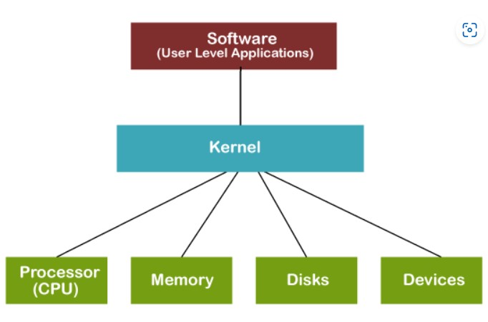

Fig. Kernel Layout

Slide 9
During normal system startup, a computer's basic input/output system, or BIOS, completes a hardware bootstrap or initialization.
It then runs a bootloader which loads the kernel from a storage device -- such as a hard drive -- into a protected memory space.
Once the kernel is loaded into computer memory, the BIOS transfers control to the kernel.
It then loads other OS components to complete the system startup and make control available to users through a desktop or other user interface.
If the kernel is damaged or cannot load successfully, the computer will be unable to start completely -- if at all.
This will require service to correct hardware damage or restore the operating system kernel to a working version.

Slide 10
What is the purpose of the kernel?
In broad terms, an OS kernel performs three primary jobs.
It provides the interfaces needed for users and applications to interact with the computer.
It launches and manages applications.
It manages the underlying system hardware devices.

Slide 11
Computer system architecture
A computer system can be organized in a number of different ways, which we can categorize roughly according to the number of general-purpose processors used.

Slide 12
Single-Processor Systems
Many years ago, most computer systems used a single processor containing one CPU with a single processing core.
The core is the component that executes instructions and registers for storing data locally.
The one main CPU with its core is capable of executing a general-purpose instruction set, including instructions from processes.
These systems have other special-purpose processors as well.
They may come in the form of device-specific processors, such as disk, keyboard, and graphics controllers.
All of these special-purpose processors run a limited instruction set and do not run processes.
Sometimes, they are managed by the operating system, in that the operating system sends them information about their next task and monitors their status.

Slide 13
A single processor system contains only one processor. So only one process can be executed at a time and then the process is selected from the ready queue.
Most general purpose computers contain the single processor systems as they are commonly in use.
A single processor system can be further described using the diagram below −

Slide 14
For example, a disk-controller microprocessor receives a sequence of requests from the main CPU core and implements its own disk queue and scheduling algorithm.
This arrangement relieves the main CPU of the overhead of disk scheduling.
PCs contain a microprocessor in the keyboard to convert the keystrokes into codes to be sent to the CPU.
In other systems or circumstances, special-purpose processors are low-level components built into the hardware.
The operating system cannot communicate with these processors; they do their jobs autonomously.
The use of special-purpose microprocessors is common and does not turn a single-processor system into a multiprocessor.

Slide 15
Application 1
Application 2
Application n
Operating System
Processor
Fig. Single Purpose Processor

Slide 16
If there is only one general-purpose CPU with a single processing core, then the system is a single-processor system.
According to this definition, however, very few contemporary computer systems are single-processor systems.
System using a single processor i.e. there is one main CPU
They have other special purpose processors as well
Use of special purpose microprocessor has not turns a single processor system into a multi processor
If there is only one general purpose CPU, then the system is a single processor system

Slide 17
Multiprocessor Systems
Multiprocessor systems (also known as parallel systems or tightly coupled systems) are growing in importance.
Many processes can run simultaneously.
Such systems have two or more processors in close communication, sharing the computer bus and sometimes the clock, memory, and peripheral devices.
The definition of multiprocessor has evolved over time and now includes multicore systems, in which multiple computing cores reside on a single chip.
Multicore systems can be more efficient than multiple chips with single cores because on-chip communication is faster than between-chip communication.
In addition, one chip with multiple cores uses significantly less power than multiple single-core chips, an important issue for mobile devices as well as laptops.

Slide 18
Multiprocessor systems have three main advantages:
Increased throughput:
By increasing the number of processors, we expect to get more work done in less time.
When multiple processors cooperate on a task, a certain amount of overhead is incurred in keeping all the parts working correctly.
This overhead, plus contention for shared resources, lowers the expected gain from additional processors.
Processing time required by system software

Slide 19
2. Economy of scale:
Multiprocessor systems can cost less than equivalent multiple single-processor systems, because they can share peripherals, mass storage, and power supplies.
If several programs operate on the same set of data, it is cheaper to store those data on one disk and to have all the processors share them than to have many computers with local disks and many copies of the data.
3. Increased reliability.
If functions can be distributed properly among several processors, then the failure of one processor will not halt the system, only slow it down.
If we have ten processors and one fails, then each of the remaining nine processors can pick up a share of the work of the failed processor.
Thus, the entire system runs only 10 percent slower, rather than failing altogether.

Slide 20
The multiple-processor systems in use today are of two types
Symmetric multiprocessing (SMP):
The most common systems use in which each processor performs all tasks within the operating system.
The most common multiprocessor systems use symmetric multiprocessing (SMP), in which each peer CPU processor performs all tasks, including operating-system functions and user processes.
The following figure illustrates a typical SMP architecture with two processors, each with its own CPU.
Notice that each CPU processor has its own set of registers, as well as a private—or local— cache.
However, all processors share physical memory over the system bus. The benefit of this model is that many processes can run simultaneously.

Slide 21
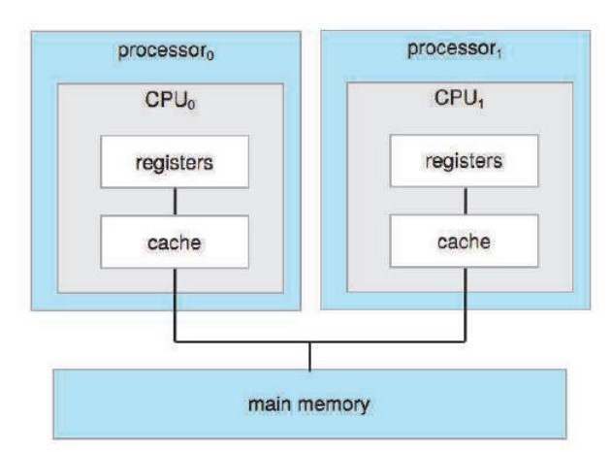
Fig. Symmetric multiprocessing architecture

Slide 22
Asymmetric multiprocessing:
Each processor is assigned a specific task.
Asymmetric multiprocessor systems are a part of multiprocessor systems along with symmetric multiprocessor systems.
Multiprocessor systems have multiple processors working in parallel that share the computer clock, memory, bus, peripheral devices etc.
All the processors are not treated equally in asymmetric multiprogramming.
For example, a processor may handle only I/O related operations and another may handle only operating system code.

Slide 23
This is in direct contrast to symmetric multiprocessing systems because there all processors are treated equally and may perform any required operation.
The processors in asymmetric multiprocessing may have a master slave relationship i.e. a processor may assign processes to other processors.
Asymmetric multiprocessing systems were the only options available before symmetric multiprocessing systems evolved.
Even currently, they are a cheaper option as compared to symmetric multiprocessing systems.

Slide 24
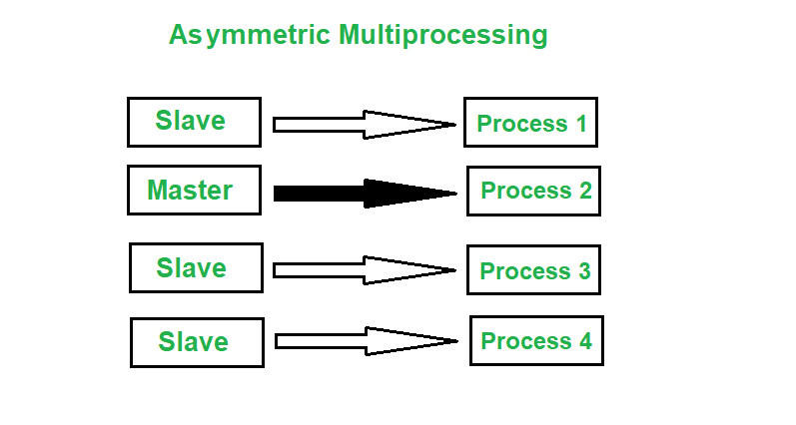
Fig. Asymmetric Multiprocessing

Slide 25
Clustered Systems
Clustered system is an another type of multiple-CPU system.
Clustered systems differ from multiprocessor systems, however, in that they are composed of two or more individual systems coupled together.
The generally accepted definition is that clustered computers share storage and are closely linked via a local-area network (LAN) or a faster interconnect such as InfiniBand.
Clustering is usually used to provide high-availability service; that is, service will continue even if one or more systems in the cluster fail.
Notes:
Infiniband: facilitates high-speed communications between interconnected nodes

Slide 26
Clustering can be structured asymmetrically or symmetrically.
High availability provides increased reliability, which is crucial in many applications.
Some cluster products support dozens of systems in a cluster, as well as clustered nodes that are separated by miles.
Many of these improvements are made possible by storage-area networks (SANs).

Slide 27
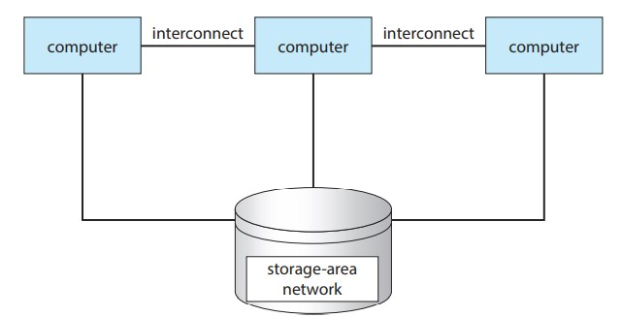
Fig. General structure of a clustered system

Slide 28
In asymmetric clustering, one machine is in hot-standby mode while the other is running the applications.
The hot-standby host machine does nothing but monitor the active server.
If that server fails, the hot-standby host becomes the active server
Hot standby is the term used to describe the ability to connect to the server and run read-only queries while the server is in archive recovery or standby mode.

Slide 29
In symmetric clustering, two or more hosts are running applications and are monitoring each other.
This structure is obviously more efficient, as it uses all of the available hardware.
However, it does require that more than one application be available to run.
Since a cluster consists of several computer systems connected via a network, clusters can also be used to provide high-performance computing environments.
Such systems can supply significantly greater computational power than single-processor or even SMP systems because they can run an application concurrently on all computers in the cluster.

Slide 30
Cluster technology is changing rapidly.
Some cluster products support thousands of systems in a cluster, as well as clustered nodes that are separated by miles.
Many of these improvements are made possible by storage-area networks (SANs), which allow many systems to attach to a pool of storage.
If the applications and their data are stored on the SAN, then the cluster software can assign the application to run on any host that is attached to the SAN.
If the host fails, then any other host can take over.
In a database cluster, dozens of hosts can share the same database, greatly increasing performance and reliability.

